Slide 1


Chapter 3:
Kubernetes API Overview and resources
Agile Brains Consulting
1
©Agile Brains Consulting Inc. All rights reserved. Not to be reproduced without prior written consent.

Slide 2
Table of Content
Pod
Controllers – ReplicaSet, ReplicationController, Deployment
Services
Storage and Volumes
StorageClass
Labels
Namespaces
Secret
ConfigMap
DaemonSet
Job and CronJob
Pod Priority and Pre-emption
Node Role and Taints
Resource Quotas
Authorization and Authentication
Agile Brains Consulting
2
©Agile Brains Consulting Inc. All rights reserved. Not to be reproduced without prior written consent.

Slide 3
Pods
Agile Brains Consulting
3
©Agile Brains Consulting Inc. All rights reserved. Not to be reproduced without prior written consent.

Slide 4
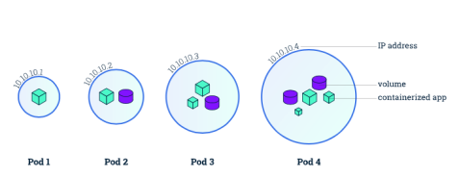
Kubernetes: Pods
The smallest unit that can be scheduled to be deployed through K8s is called a pod.
Homogeneous group of containers.
This group of containers would share storage, Linux namespaces, cgroups, IP addresses. These are co-located, hence share resources and are always scheduled together.
Pods are not intended to live long. They are created, destroyed and re-created on demand, based on the state of the server and the service itself.
Containers in a pod share
IP address and port space
Filesystem
Storage (Volumnes)
Labels
Secrets
Agile Brains Consulting
4
©Agile Brains Consulting Inc. All rights reserved. Not to be reproduced without prior written consent.
Notes:
Additionally, pods can be tagged with a label for recommended scheduling advice

Slide 5
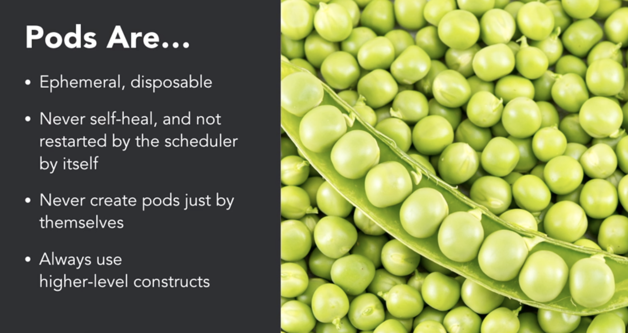
Kubernetes: Pods
Agile Brains Consulting
5
©Agile Brains Consulting Inc. All rights reserved. Not to be reproduced without prior written consent.
Notes:
Additionally, pods can be tagged with a label for recommended scheduling advice

Slide 6
Kubernetes: Pod States
Pending (request accepted, one or more containers are still being created)
Running (Pod has been bound to a node, all of the Containers have been created. At least one Container is still running, or is in the process of starting or restarting.)
Succeeded (All Containers in the Pod have terminated in success, and will not be restarted)
Failed (All Containers in the Pod have terminated, and at least one container has terminated with some failure)
CrashLoopBackOff (pod starting, crashing, starting again, and then crashing again.)
Agile Brains Consulting
6
©Agile Brains Consulting Inc. All rights reserved. Not to be reproduced without prior written consent.
Notes:
Additionally, pods can be tagged with a label for recommended scheduling advice

Slide 7
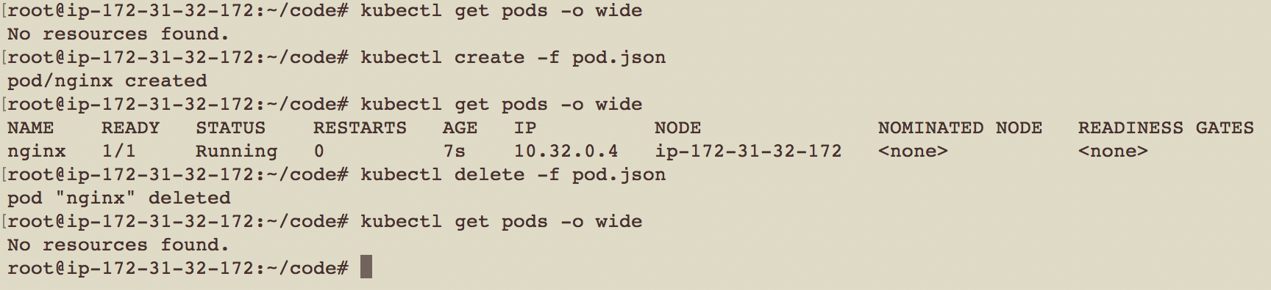
pod.yml
apiVersion: v1
kind: Pod
metadata:
name: nginx
labels:
name: nginx
spec:
containers:
- name: nginx
image: nginx
ports:
- containerPort: 80
pod.json
{
"kind":"Pod",
"apiVersion":"v1",
"metadata":{"name":"nginx","labels":{"name":"nginx"}},
"spec":{"containers":[{"name":"nginx","image":"nginx","ports":[{"containerPort":80}]}]}
}
** Delete this pod, it won’t get re-created automatically
Agile Brains Consulting
7
©Agile Brains Consulting Inc. All rights reserved. Not to be reproduced without prior written consent.
Notes:
Create a simple pod.yaml with the following contents
apiVersion: v1
kind: Pod
metadata:
name: nginx
labels:
name: nginx
spec:
containers:
- name: nginx
image: nginx
ports:
- containerPort: 80
2. Kubectl create –f pod.yaml
3. Kubectl get pods
This highlights an example of Kubernetes deployment creation. As with many Kubernetes objects, deployments are usually created from a file such as a yaml or json. While this could be done via command line it is often impractical to do so.
Further reading:
https://kubernetes.io/docs/concepts/workloads/controllers/deployment/#creating-a-deployment

Slide 8
Controllers
Agile Brains Consulting
8
©Agile Brains Consulting Inc. All rights reserved. Not to be reproduced without prior written consent.

Slide 9
Controllers
Kubernetes contains a number of higher-level abstractions called Controllers. Controllers build upon the basic objects, and provide additional functionality and convenience features.
They are
ReplicationController
ReplicaSet
Deployment
DaemonSet – used for specific purpose
Job
CronJob
Agile Brains Consulting
9
©Agile Brains Consulting Inc. All rights reserved. Not to be reproduced without prior written consent.

Slide 10
Replication Controller
The original form of replication in Kubernetes. Its now preferred to use Replicate Sets via a Deployment
Ensures that a specified number of pod replicas are running at any one time. If a pod does crash, the Replication Controller replaces it.
Allows you to scale the number of pods, and to update or delete multiple pods with a single command.
Agile Brains Consulting
10
©Agile Brains Consulting Inc. All rights reserved. Not to be reproduced without prior written consent.

Slide 11
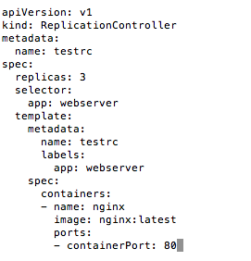
Replication Controller
This file says:
We need to have 3 replicas of this Pod
The Pod has 1 container (image: nginx)
Create the Replication controller:
kubectl create -f rc.yaml
Agile Brains Consulting
11
©Agile Brains Consulting Inc. All rights reserved. Not to be reproduced without prior written consent.

Slide 12
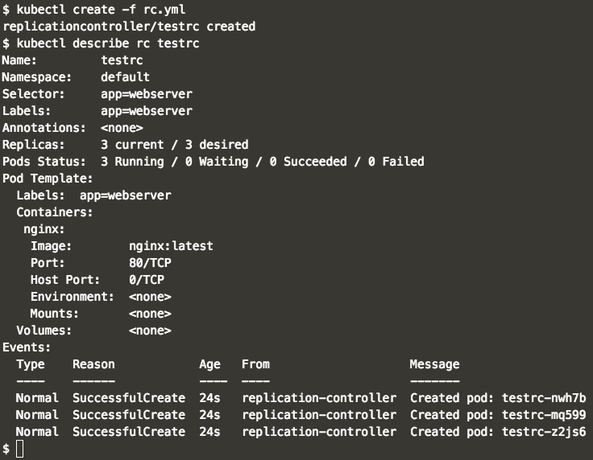
Replication Controller
Agile Brains Consulting
12
©Agile Brains Consulting Inc. All rights reserved. Not to be reproduced without prior written consent.

Slide 13
Replica-set
Agile Brains Consulting
13
©Agile Brains Consulting Inc. All rights reserved. Not to be reproduced without prior written consent.

Slide 14
Replica Set
It is essentially the same as Replication Controller except that it has more options for selector:
matchLabels
matchExpressions
Replica set doesn’t support rolling update, instead use deployment
Agile Brains Consulting
14
©Agile Brains Consulting Inc. All rights reserved. Not to be reproduced without prior written consent.

Slide 15
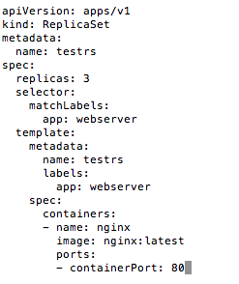
Replica Set
This Replica Set has the same rules as the Replication Controller in the previous slide.
This file says:
We need to have 3 replicas of this Pod
The Pod has 1 container (image: nginx)
Create the Replication controller:
kubectl create -f rs.yaml
Agile Brains Consulting
15
©Agile Brains Consulting Inc. All rights reserved. Not to be reproduced without prior written consent.

Slide 16
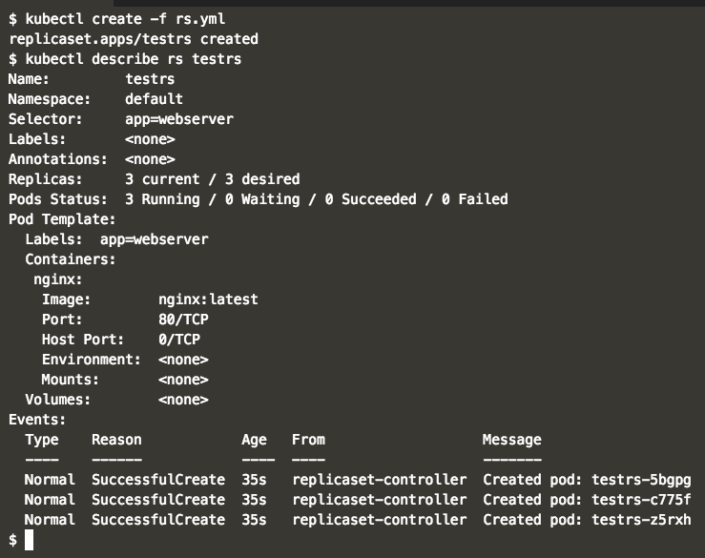
Replica Set
Agile Brains Consulting
16
©Agile Brains Consulting Inc. All rights reserved. Not to be reproduced without prior written consent.

Slide 17
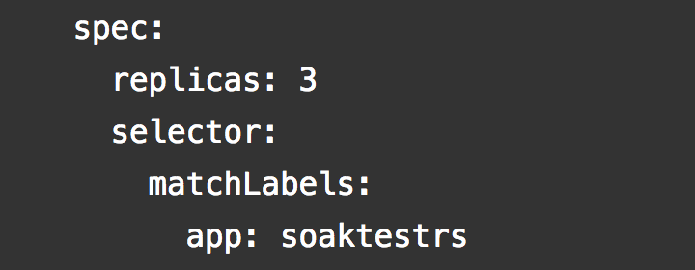
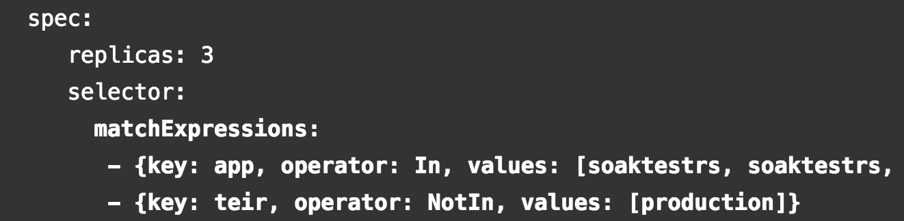
Replica Set – match labels and expressions
Agile Brains Consulting
17
©Agile Brains Consulting Inc. All rights reserved. Not to be reproduced without prior written consent.

Slide 18
Deployments
Agile Brains Consulting
18
©Agile Brains Consulting Inc. All rights reserved. Not to be reproduced without prior written consent.

Slide 19
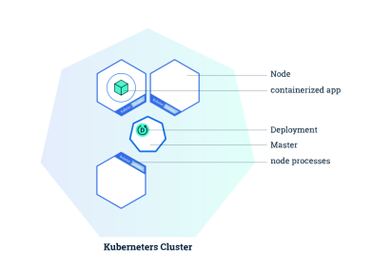
Kubernetes: Deployments
Allows you to deploy a (self-healing) instance of an application.
Self Healing: Continuously monitors and replaces instances if necessary
Provides declarative updates for Pods and Replica Sets
Updates actual state to desired state at a controlled rate
For example: Current state is 3 instances of Tomcat. Desired state is 5 instances of Tomcat -> Create 2 more instances of Tomcat
Agile Brains Consulting
19
©Agile Brains Consulting Inc. All rights reserved. Not to be reproduced without prior written consent.
Notes:
Deployments (and controllers) are loops that maintain state.

Slide 20
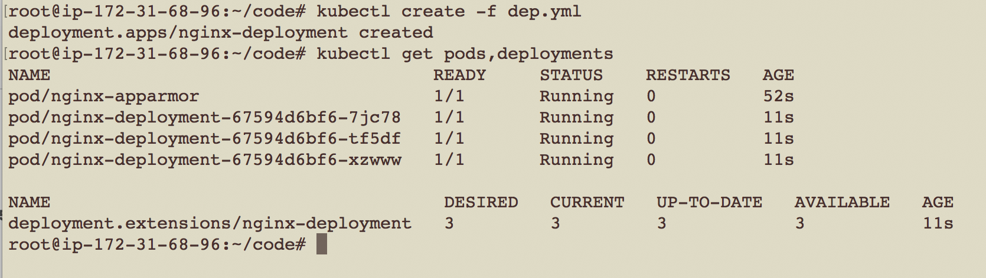
dep.yml
apiVersion: apps/v1
kind: Deployment
metadata:
name: nginx-deployment
labels:
app: nginx
spec:
replicas: 3
selector:
matchLabels:
app: nginx
template:
metadata:
labels:
app: nginx
spec:
containers:
- name: nginx
image: nginx:1.7.9
ports:
- containerPort: 80
Agile Brains Consulting
20
©Agile Brains Consulting Inc. All rights reserved. Not to be reproduced without prior written consent.

Slide 21
Kubectl create/apply
kubectl create -f <yaml_file>
kubectl create -f <yaml_file_1> -f <yaml_file_2>
kubectl create -f <json_file>
kubectl create -f <url_name>
kubectl create -f <directory_name>
kubectl create tell the Kubernetes API what you want to create, replace or delete. It’s a imperative approach and good if single person is working in the team.
kubectl apply – apply changes to a live object. It’s a declarative approach and good when you want to maintain versions
Agile Brains Consulting
21
©Agile Brains Consulting Inc. All rights reserved. Not to be reproduced without prior written consent.
Notes:
Create a pod.yaml with the following contents
apiVersion: v1
kind: Pod
metadata:
name: nginx
labels:
name: nginx
spec:
containers:
- name: nginx
image: nginx
ports:
- containerPort: 80
2. Kubectl create –f pod.yaml
3. Kubectl get pods
This highlights an example of Kubernetes deployment creation. As with many Kubernetes objects, deployments are usually created from a file such as a yaml or json. While this could be done via command line it is often impractical to do so.
Further reading:
https://kubernetes.io/docs/concepts/workloads/controllers/deployment/#creating-a-deployment
Note: This is a simple pod. This is interesting.

Slide 22
Lab (rc, rs, deploy)
Exercise to create Replication Controllers, Replica Sets and Deployments and describe their functions
Check the results and describe the objects
sudo su -
git clone https://github.com/shekhar2010us/kubernetes_teach_git.git
cd kubernetes_teach_git/ex1/
https://github.com/shekhar2010us/kubernetes_teach_git/blob/master/ex1/rc_rs_deployment.md
Agile Brains Consulting
22
©Agile Brains Consulting Inc. All rights reserved. Not to be reproduced without prior written consent.

Slide 23
Services
Agile Brains Consulting
23
©Agile Brains Consulting Inc. All rights reserved. Not to be reproduced without prior written consent.

Slide 24
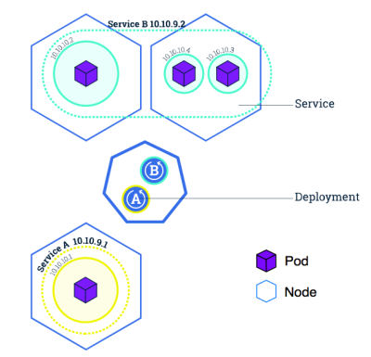
Kubernetes: Service
Abstraction regarding a set of pods which enables load balancing, traffic exposure, load balancing and service discovery.
pods to die and replicate in Kubernetes without affecting your application.
Enable loose coupling between different Pods.
Provides a stable virtual IP and port
Services allow Pods to receive traffic.
Each Pod has a unique IP but those IP addresses are not exposed outside the Pod without a service.
Agile Brains Consulting
24
©Agile Brains Consulting Inc. All rights reserved. Not to be reproduced without prior written consent.

Slide 25
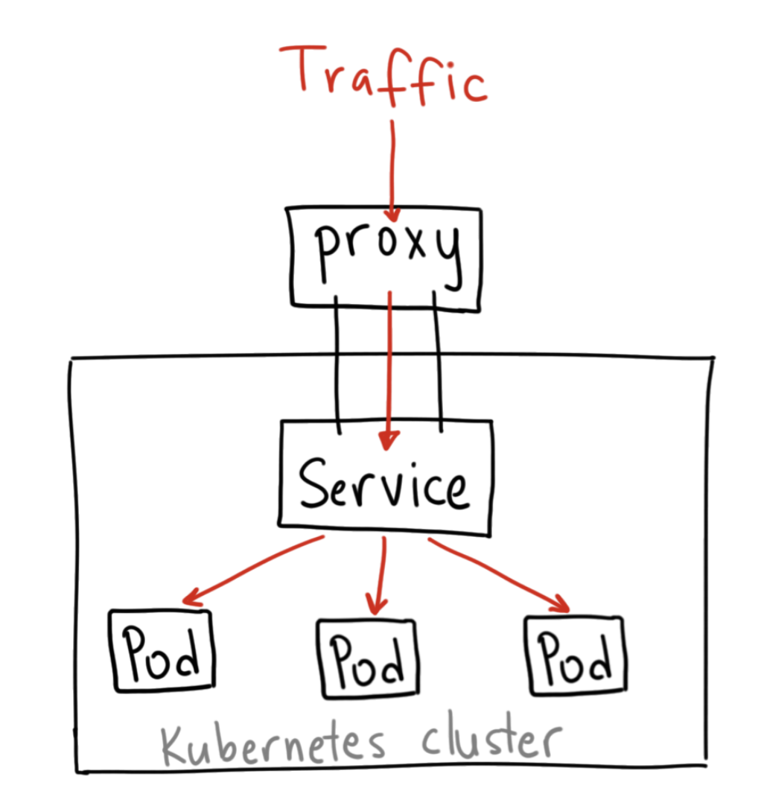
ClusterIP Service
Cluster IP
Expose the service on a cluster-internal IP
Default Kubernetes Service
Using this makes the service only reachable from
within the cluster (no external access)
Access through proxy
kubectl run nginx-dep --image nginx --port 80
kubectl expose deploy/nginx-dep --name nginx-svc
kubectl get deploy,svc -o wide
kubectl proxy &
curl http://localhost:8001/api/v1/namespaces/default/services/nginx-service/proxy/
Agile Brains Consulting
25
©Agile Brains Consulting Inc. All rights reserved. Not to be reproduced without prior written consent.
Notes:
When the service type is set to LoadBalancer, Kubernetes provides functionality equivalent to type=<ClusterIP> to pods within the cluster and extends it by programming the (external to Kubernetes) load balancer with entries for the Kubernetes pods. The Kubernetes service controller automates the creation of the external load balancer, health checks (if needed), firewall rules (if needed) and retrieves the external IP allocated by the cloud provider and populates it in the service object.
https://medium.com/google-cloud/kubernetes-nodeport-vs-loadbalancer-vs-ingress-when-should-i-use-what-922f010849e0 and https://medium.com/google-cloud/kubernetes-from-load-balancer-to-pod-3f2399637b0c

Slide 26
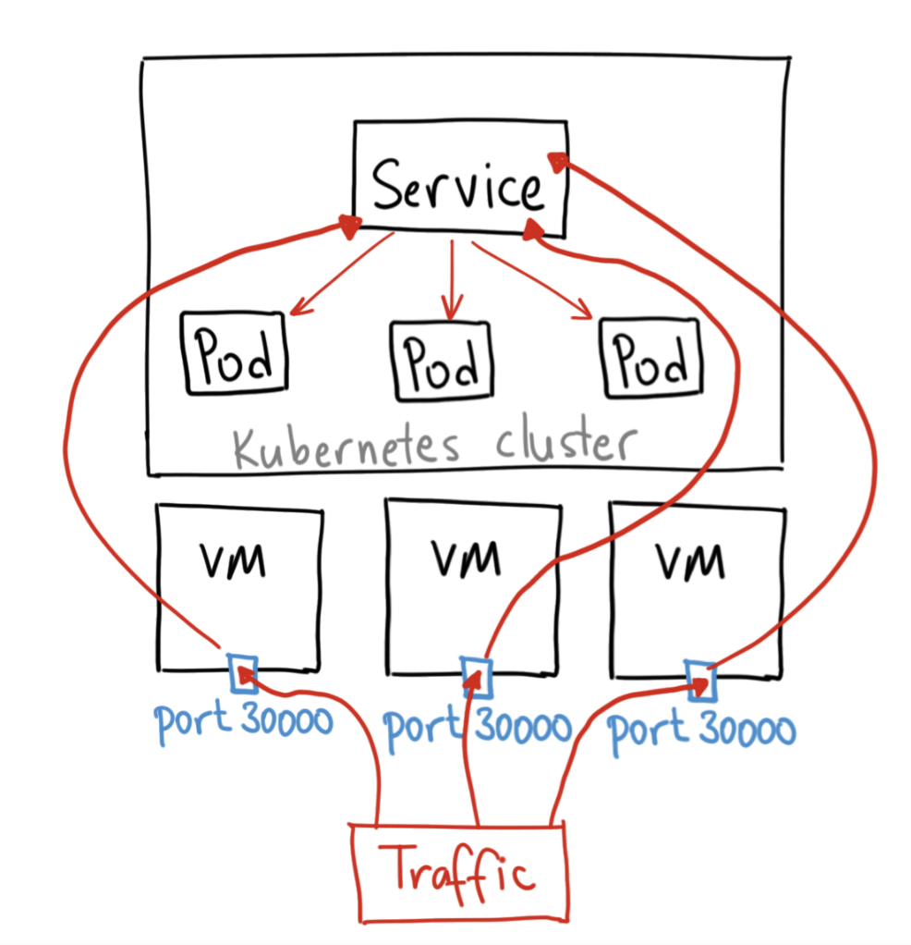
NodePort Service
NodePort
Opens a specific port on all the Nodes (the VMs)
Traffic that is sent to this port is forwarded to the service.
One service per port, only use ports 30000–32767
Agile Brains Consulting
26
©Agile Brains Consulting Inc. All rights reserved. Not to be reproduced without prior written consent.
Notes:
When the service type is set to LoadBalancer, Kubernetes provides functionality equivalent to type=<ClusterIP> to pods within the cluster and extends it by programming the (external to Kubernetes) load balancer with entries for the Kubernetes pods. The Kubernetes service controller automates the creation of the external load balancer, health checks (if needed), firewall rules (if needed) and retrieves the external IP allocated by the cloud provider and populates it in the service object.
https://medium.com/google-cloud/kubernetes-nodeport-vs-loadbalancer-vs-ingress-when-should-i-use-what-922f010849e0 and https://medium.com/google-cloud/kubernetes-from-load-balancer-to-pod-3f2399637b0c

Slide 27
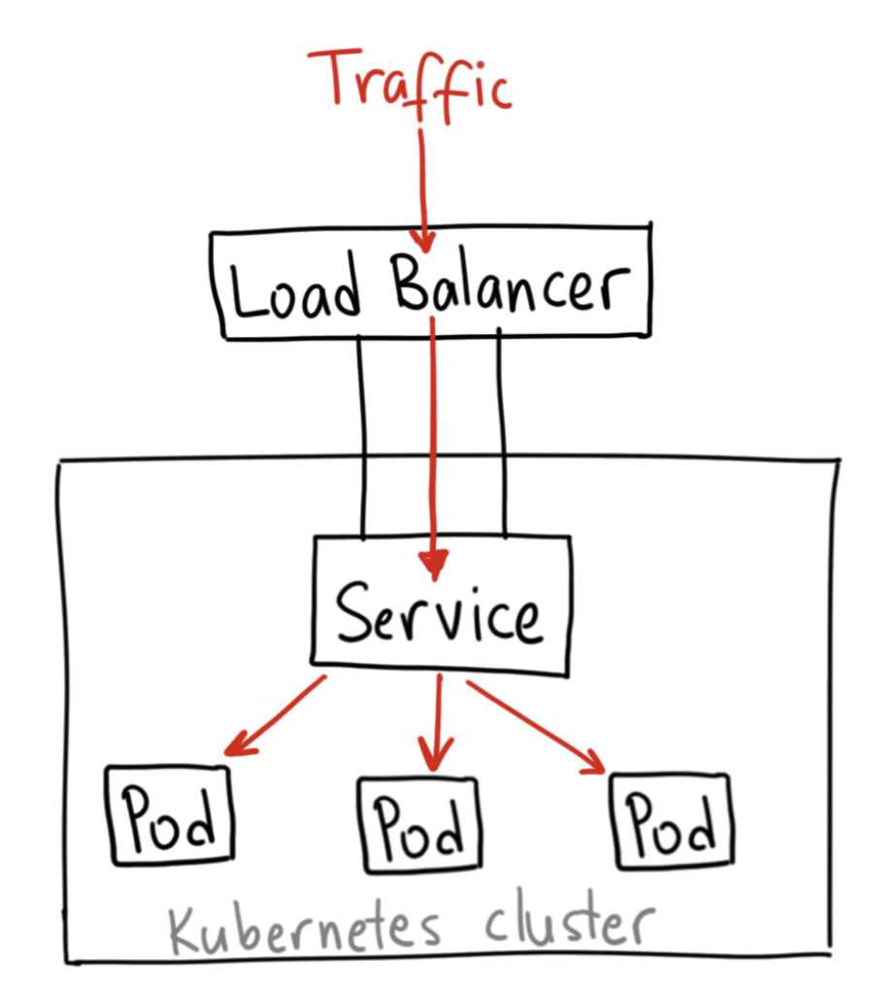
LoadBalancer Service
Load Balancer
Spin up a Network Load Balancer that provides a single IP
address that will forward all traffic to your service
** kubernetes does not offer an implementation of network load-balancers for bare metal clusters.
The implementations of Network LB that Kubernetes does ship with are all glue code that calls out to various cloud platforms (GCP, AWS, Azure…). If you’re not running on a supported cloud platform; LoadBalancer will remain in the “pending” state indefinitely when created.
Agile Brains Consulting
27
©Agile Brains Consulting Inc. All rights reserved. Not to be reproduced without prior written consent.
Notes:
When the service type is set to LoadBalancer, Kubernetes provides functionality equivalent to type=<ClusterIP> to pods within the cluster and extends it by programming the (external to Kubernetes) load balancer with entries for the Kubernetes pods. The Kubernetes service controller automates the creation of the external load balancer, health checks (if needed), firewall rules (if needed) and retrieves the external IP allocated by the cloud provider and populates it in the service object.
https://medium.com/google-cloud/kubernetes-nodeport-vs-loadbalancer-vs-ingress-when-should-i-use-what-922f010849e0 and https://medium.com/google-cloud/kubernetes-from-load-balancer-to-pod-3f2399637b0c

Slide 28
root@ip-172-31-68-96:~# kubectl get svc
NAME TYPE CLUSTER-IP EXTERNAL-IP PORT(S) AGE
kubernetes ClusterIP 10.96.0.1 <none> 443/TCP 37m
root@ip-172-31-68-96:~#
root@ip-172-31-68-96:~# kubectl expose deployment nginx-deployment --type=LoadBalancer --name=nginx-service
service/nginx-service exposed
root@ip-172-31-68-96:~#
root@ip-172-31-68-96:~# kubectl get svc
NAME TYPE CLUSTER-IP EXTERNAL-IP PORT(S) AGE
kubernetes ClusterIP 10.96.0.1 <none> 443/TCP 37m
nginx-service LoadBalancer 10.102.89.83 <pending> 80:31095/TCP 3s
root@ip-172-31-68-96:~#
Agile Brains Consulting
28
©Agile Brains Consulting Inc. All rights reserved. Not to be reproduced without prior written consent.
Notes:
-- to make NodePort work - https://stackoverflow.com/questions/45543694/kubernetes-cluster-on-aws-with-kops-nodeport-service-unavailable/45561848#45561848 , show this in a 2 cluster node, using nodeport and exposing , only the inbound rule for that node - http://34.222.12.167:32083/
kubectl expose pod sharevol --type NodePort --name sharevol-service --port 3006
Example - create node , expose as nodePort service
kubectl expose pod nginx-apparmor --type NodePort --name nginx-apparmor-service --port 3003
-- to make NodePort work - https://stackoverflow.com/questions/45543694/kubernetes-cluster-on-aws-with-kops-nodeport-service-unavailable/45561848#45561848 , show this in a 2 cluster node, using nodeport and exposing , only the inbound rule for that node - http://34.222.12.167:32083/

Slide 29
Lab (Services)
For all the concepts discussed until now
Create pods, Services, Deployments
Various ways to use the create command
We already have the git repo cloned in our machines.
$$ cd to the ex2
https://github.com/shekhar2010us/kubernetes_teach_git/blob/master/ex2/pod_deploy_service.md
Agile Brains Consulting
29
©Agile Brains Consulting Inc. All rights reserved. Not to be reproduced without prior written consent.
Notes:
kubectl get services --all-namespaces
This reveals the kubernetes services that are usually running as part of the kubernetes system namespace.
http://kubernetesbyexample.com/services/
As mentioned previously, a Service is backed by a group of Pods. These Pods are exposed through endpoints. The Service’s selector will be evaluated continuously and the results will be POSTed to an Endpoints object also named my-nginx. When a Pod dies, it is automatically removed from the endpoints, and new Pods matching the Service’s selector will automatically get added to the endpoints. Check the endpoints, and note that the IPs are the same as the Pods created in the first step:

Slide 30
Kubernetes Popular commands
kubectl get - list resources about a target.
kubectl get services, kubectl get pods
kubectl describe - show basic information about a resource
kubectl describe pods my-pod
kubectl logs - print the logs from a container in a pod. Extremely useful
kubectl logs my-pod
kubectl exec - execute a command on a container in a pod
Agile Brains Consulting
30
©Agile Brains Consulting Inc. All rights reserved. Not to be reproduced without prior written consent.
Notes:
Trivia: Some internal Kubernetes engineers pronounce kubectl as ‘kubecuttle’
kubectl apply vs kubectl replace, create , vs using config files - https://medium.com/bitnami-perspectives/imperative-declarative-and-a-few-kubectl-tricks-9d6deabdde
Objects using Imperative commands, objects using imperative config files, and declarative commands

Slide 31
Storage
Agile Brains Consulting
31
©Agile Brains Consulting Inc. All rights reserved. Not to be reproduced without prior written consent.

Slide 32
Kubernetes: Volumes
On-disk files in a container are the simplest place for an application to write data, but this approach has drawbacks. The files are lost when the container crashes or stops for any other reason. Furthermore, files within a container are inaccessible to other containers running in the same Pod. The Kubernetes Volume abstraction addresses both of these issues.
A directory accessible to all containers in a pod
Volumes out live containers that run within a pod
May be passed between pods
Data is preserved across container restarts
Agile Brains Consulting
32
©Agile Brains Consulting Inc. All rights reserved. Not to be reproduced without prior written consent.

Slide 33
Kubernetes: Persistent Volume
Persistent storage in a cluster
Separate from PersistentVolumeClaim, which is a request for storage.
May be created ahead of time in a static manner for use by a cluster
May be created dynamically from available, unclaimed resources
May be freed and passed from user to user so care should be taken to delete contents when done with use
Agile Brains Consulting
33
©Agile Brains Consulting Inc. All rights reserved. Not to be reproduced without prior written consent.

Slide 34
Kubernetes: Persistent Volumes
PV: Storage in the cluster that has been provisioned by an administrator (static or dynamic) and is independent of any individual pod that uses the PV.
Following volumes are supported by Kubernetes:
GCEPersistentDisk ; AWSElasticBlockStore
AzureFile ; AzureDisk
FC (Fibre Channel) ; FlexVolume
Flocker ; NFS
iSCSI ; RBD (Ceph Block Device)
CephFS ; Cinder (OpenStack block storage)
Glusterfs ; VsphereVolume
Portworx Volumes ; ScaleIO Volumes
StorageOS
Agile Brains Consulting
34
©Agile Brains Consulting Inc. All rights reserved. Not to be reproduced without prior written consent.

Slide 35
Example: Persistent Volumes
apiVersion: v1
kind: PersistentVolume
metadata:
name: pv0003
spec:
capacity:
storage: 5Gi
volumeMode: Filesystem
accessModes:
- ReadWriteOnce
persistentVolumeReclaimPolicy: Recycle
mountOptions:
- hard
- nfsvers=4.1
nfs:
path: /tmp
server: 172.17.0.2
Agile Brains Consulting
35
©Agile Brains Consulting Inc. All rights reserved. Not to be reproduced without prior written consent.

Slide 36
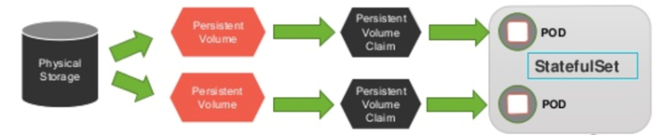
Kubernetes: Persistent Volume Claims
PVC: Request for a storage by a user, it is similar to pod and it can request specific size and access modes (e.g., can be mounted once read/write or many times read-only).
Agile Brains Consulting
36
©Agile Brains Consulting Inc. All rights reserved. Not to be reproduced without prior written consent.

Slide 37
Example: Persistent Volume Claim
kind: PersistentVolumeClaim
apiVersion: v1
metadata:
name: user-service-war-pv-claim
spec:
accessModes:
- ReadWriteOnce
resources:
requests:
storage: 1Gi
Agile Brains Consulting
37
©Agile Brains Consulting Inc. All rights reserved. Not to be reproduced without prior written consent.

Slide 38
Example: Deployment using PVC
apiVersion: extensions/v1beta1
kind: Deployment
metadata:
name: userservice
spec:
replicas: 1
template:
……
spec:
containers:
……
volumeMounts:
- mountPath: /usr/local/tomcat/webapps/user-service-1.0.war
name: user-service-war
volumes:
- name: user-service-war
persistentVolumeClaim:
claimName: user-service-war-pv-claim
Agile Brains Consulting
38
©Agile Brains Consulting Inc. All rights reserved. Not to be reproduced without prior written consent.

Slide 39
Lab (Volume, PV, PVC)
create pods,PV and PVC
Experiment with creating end to end application, mount volume, read from shared pod
Fix a bug
cd to ex6
6.1 Exercise of Volume
https://github.com/shekhar2010us/kubernetes_teach_git/blob/master/ex6/create_volumes.md
6.2 Exercise on PV, PVC
https://github.com/shekhar2010us/kubernetes_teach_git/blob/master/ex6/create_pv.md
Agile Brains Consulting
39
©Agile Brains Consulting Inc. All rights reserved. Not to be reproduced without prior written consent.
Notes:
https://github.com/gravitational/workshop/blob/master/k8s101.md
Git clone https://github.com/gravitational/workshop.git
Sections:
Deployments and Replicasets
Services
Back to Deployments
Configuration management basics

Slide 40
Storage Classes
Agile Brains Consulting
40
©Agile Brains Consulting Inc. All rights reserved. Not to be reproduced without prior written consent.

Slide 41
Kubernetes: Storage Classes
StorageClass provides a way for administrators to describe the “classes” of storage they offer. Different classes might map to quality-of-service levels, or to backup policies, or to arbitrary policies determined by the cluster administrators.
This concept is sometimes called “profiles” in other storage systems.
Usually required for dynamic provisioning of storage (usually done in cloud storage)
Agile Brains Consulting
41
©Agile Brains Consulting Inc. All rights reserved. Not to be reproduced without prior written consent.

Slide 42
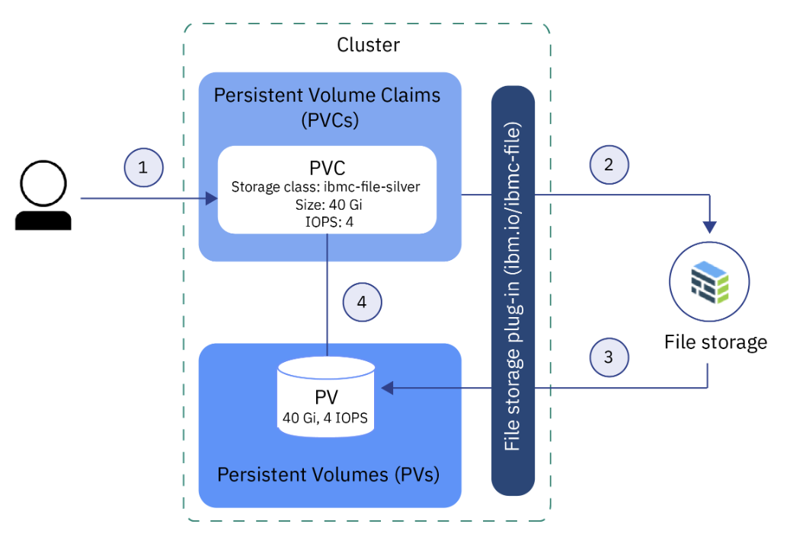
Dynamic Storage Provisioning
User creates PVC, specifying storage type, storage class, size, etc. The storage class determines types of storage. Creating PVC triggers the storage plug-in to provision storage
The storage device is ordered and provisioned into the Cloud account.
The storage plug-in creates a PV in the cluster, a virtual storage device that points to the actual storage device in your Cloud infrastructure
The PVC and PV are automatically connected to each other. The status of the PVC and the PV changes to Bound. If PVC is deleted, PV and related storage instance are also deleted.
Agile Brains Consulting
42
©Agile Brains Consulting Inc. All rights reserved. Not to be reproduced without prior written consent.

Slide 43
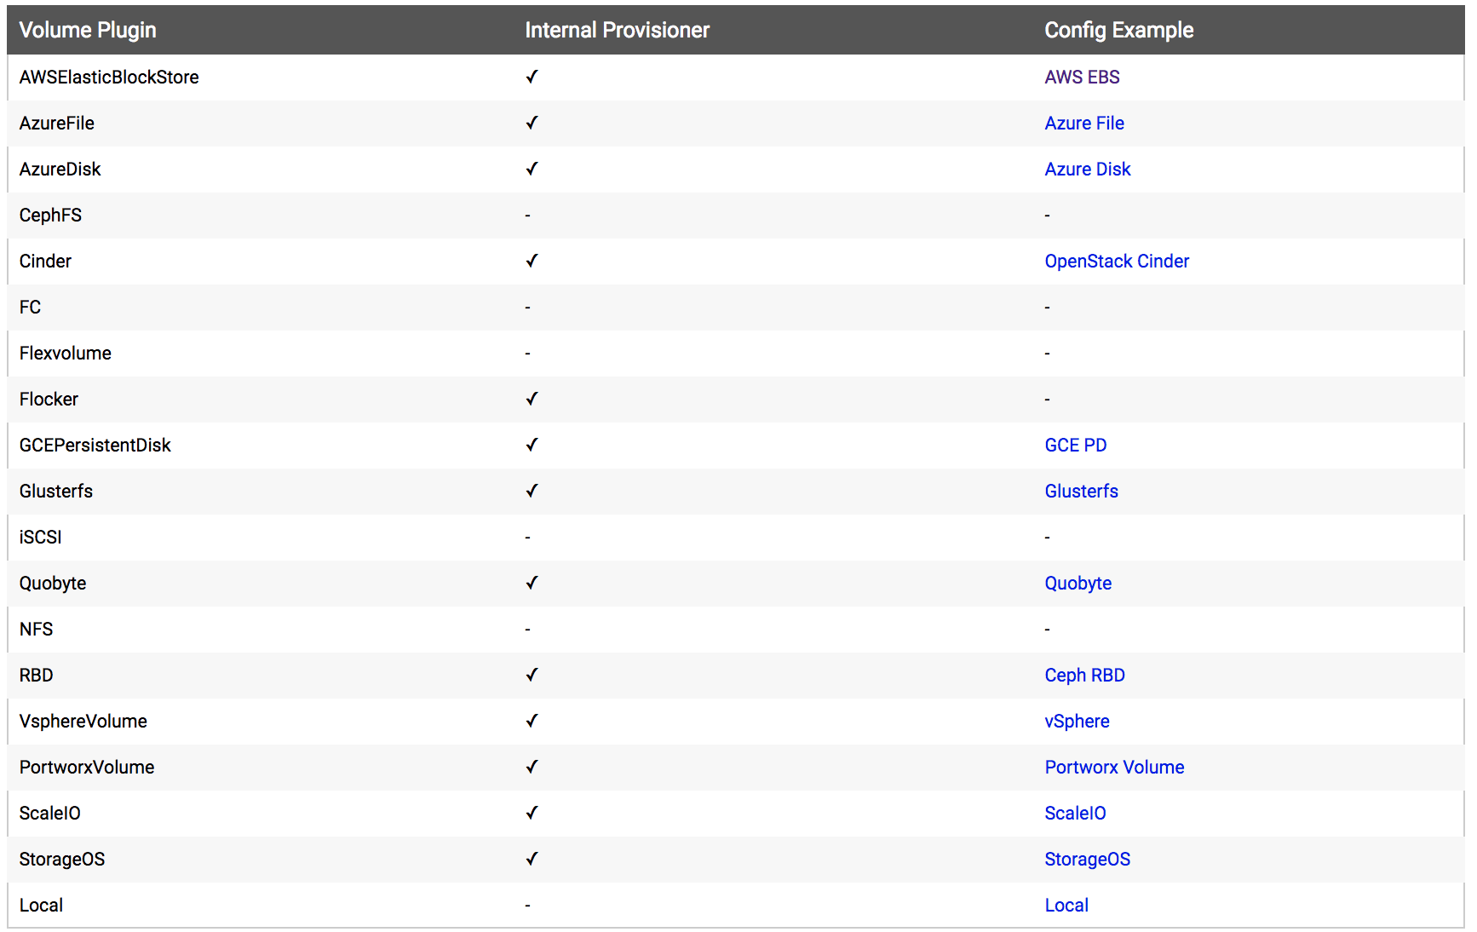
Dynamic Storage Provisioner Options
Agile Brains Consulting
43
©Agile Brains Consulting Inc. All rights reserved. Not to be reproduced without prior written consent.

Slide 44
Storage Class Examples
kind: StorageClass
apiVersion: storage.k8s.io/v1
metadata:
name: local-storage
provisioner: kubernetes.io/no-provisioner
volumeBindingMode: WaitForFirstConsumer
Provisioner – provider
Parameters – details of storage
VolumeBindingMode – When volume binding and dynamic provisioning should occur
Local
kind: StorageClass
apiVersion: storage.k8s.io/v1
metadata:
name: slow
provisioner: kubernetes.io/aws-ebs
parameters:
type: io1
iopsPerGB: “10”
fsType: ext4
kind: StorageClass
apiVersion: storage.k8s.io/v1
metadata:
name: standard
provisioner: kubernetes.io/aws-ebs
parameters:
type: gp2
reclaimPolicy: Retain
volumeBindingMode: Immdediate
AWS EBS
AWS EBS
Agile Brains Consulting
44
©Agile Brains Consulting Inc. All rights reserved. Not to be reproduced without prior written consent.

Slide 45
Labels
Agile Brains Consulting
45
©Agile Brains Consulting Inc. All rights reserved. Not to be reproduced without prior written consent.

Slide 46
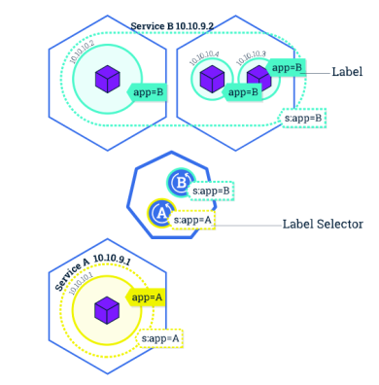
Kubernetes: Label
Key/Value pairs that can be attached to objects to enable a variety of use cases.
Designate objects for specific environments such as development, test and production
Set versions to objects
Set roles or other arbitrary information to classify objects
Can be added or modified at any time
Agile Brains Consulting
46
©Agile Brains Consulting Inc. All rights reserved. Not to be reproduced without prior written consent.
Notes:
-- Add Selectors and Field Selectors, options too for some sample commands like this

Slide 47
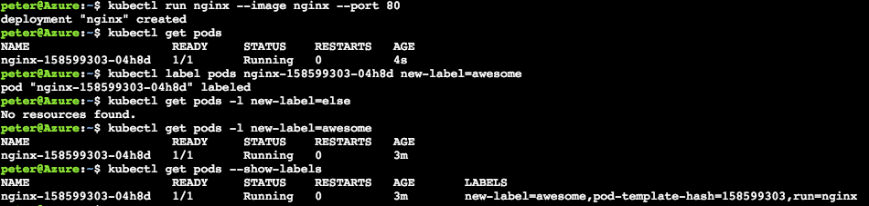
$ kubectl get pod –l name=<label>
Note: Best mechanism to organize Kubernetes objects
labels can be used to provide logical structure
divide by teams, or by environments, or versions
$ kubectl create -f helloworld-pod-with-labels.yml
$ kubectl get po --show-labels
Agile Brains Consulting
47
©Agile Brains Consulting Inc. All rights reserved. Not to be reproduced without prior written consent.
Notes:
kubectl run nginx --image nginx --port 80
kubectl get pods
kubectl label pods nginx-158599303-04h8d new-label=awesome
kubectl get pods -l new-label=else
kubectl get pods -l new-label=awesome
kubectl get pods --show-labels
http://kubernetesbyexample.com/labels/

Slide 48
Lab (Kubernetes Labels)
Create a series of pods with different labels
Query the pods based on various labels
Delete pods based on certain selectors
We have already pulled the git repo
Now cd to ex3
https://github.com/shekhar2010us/kubernetes_teach_git/blob/master/ex3/label_usage.md
Agile Brains Consulting
48
©Agile Brains Consulting Inc. All rights reserved. Not to be reproduced without prior written consent.
Notes:
Create a cluster (or reuse a cluster from earlier exercises) and connect to it
Execute the nginx example
https://github.com/kubernetes/kubernetes/blob/master/examples/simple-nginx.md
Some repetition here is intentional. You should be comfortable creating clusters, establishing a connection, verifying its healthy, and then cleaning up resources. This foundation is essential before moving on to advanced concepts

Slide 49
Namespaces
Agile Brains Consulting
49
©Agile Brains Consulting Inc. All rights reserved. Not to be reproduced without prior written consent.

Slide 50
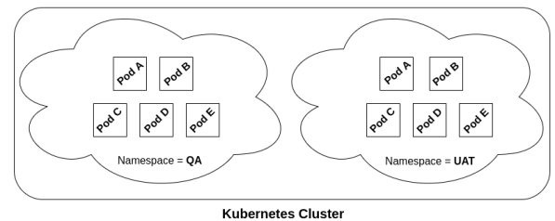
Kubernetes: Namespace
Resources are segmented within namespaces
Sandbox per developer for example
Pods will route dns to default (own) namespace
The same app could run independently in different namespaces
Namespaces create an excellent mechanism to subdivide resources and provide isolation. This enables using a cluster for multiple projects or multiple teams
Agile Brains Consulting
50
©Agile Brains Consulting Inc. All rights reserved. Not to be reproduced without prior written consent.

Slide 51
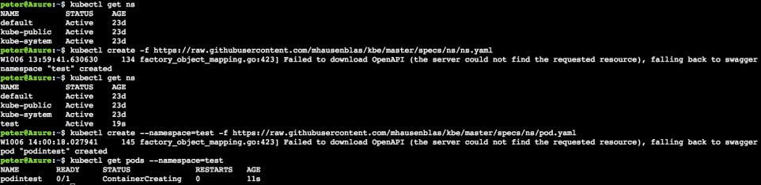
Kubernetes: Namespace
$ kubectl get po,deploy,svc,rs --all-namespaces
$ kubectl create -f <pod_config> -n <namespace_name>
$ kubectl get po -o wide
$ kubectl get po -o wide -n <namespace_name>
$ kubectl delete po simple_pod
$ kubectl delete po simple_pod -n <namespace_name>
Agile Brains Consulting
51
©Agile Brains Consulting Inc. All rights reserved. Not to be reproduced without prior written consent.
Notes:
Get default namespaces
1. kubectl get ns
Create a ‘test’ namespace
2. kubectl create -f https://raw.githubusercontent.com/mhausenblas/kbe/master/specs/ns/ns.yaml
Recheck namespaces and observe
3. kubectl get ns
Now create a pod in this new namespace
4. kubectl create --namespace=test -f https://raw.githubusercontent.com/mhausenblas/kbe/master/specs/ns/pod.yaml
Check pods in this new namespace
5. kubectl get pods --namespace=test
show the resource-quota example and exercise -
https://kubernetes.io/docs/tasks/administer-cluster/manage-resources/quota-memory-cpu-namespace/
also have a namepsace example mini
--

Slide 52
Segregating context using Namespaces
Create namespaces “dev” and “prod”
kubectl config view (get the user)
kubectl config current-context
kubectl config set-context dev --namespace=dev --cluster=<current-context> --user=<user>
kubectl config set-context prod --namespace=prod --cluster=<current-context> --user=<user>
kubectl config get-contexts
kubectl config use-context dev
## do something
kubectl config use-context prod
## do something
Agile Brains Consulting
52
©Agile Brains Consulting Inc. All rights reserved. Not to be reproduced without prior written consent.
Notes:
https://github.com/gravitational/workshop/blob/master/k8s101.md
Git clone https://github.com/gravitational/workshop.git
Sections:
Deployments and Replicasets
Services
Back to Deployments
Configuration management basics

Slide 53
Lab (Namespace)
Create a namespace
check various objects in different namespaces
Can create or delete objects from a specific namespace
cd to ex12
https://github.com/shekhar2010us/kubernetes_teach_git/blob/master/ex12/namespaces.md
Agile Brains Consulting
53
©Agile Brains Consulting Inc. All rights reserved. Not to be reproduced without prior written consent.
Notes:
https://github.com/gravitational/workshop/blob/master/k8s101.md
Git clone https://github.com/gravitational/workshop.git
Sections:
Deployments and Replicasets
Services
Back to Deployments
Configuration management basics

Slide 54
Secrets
Agile Brains Consulting
54
©Agile Brains Consulting Inc. All rights reserved. Not to be reproduced without prior written consent.

Slide 55
Kubernetes: Secrets
Kubernetes secret objects let you store and manage sensitive information, such as passwords, OAuth tokens, and ssh keys.
Using secret to store this information is safer and more flexible than putting it verbatim in a container image or Pod Lifecycle definition.
Agile Brains Consulting
55
©Agile Brains Consulting Inc. All rights reserved. Not to be reproduced without prior written consent.

Slide 56
Create Secrets – using “kubectl create secret”
Create files with the content:
Creating secrets from the file:
$ kubectl create secret generic db-user-pass --from-file=./username.txt --from-file=./password.txt
echo -n 'admin' > ./username.txt
From file
echo -n '1f3wr8sdfssf' > ./password.txt
$ kubectl create secret generic test-secret --from-literal=username='my-app' --from-literal=password='39528$vdg7Jb'
From literal
Agile Brains Consulting
56
©Agile Brains Consulting Inc. All rights reserved. Not to be reproduced without prior written consent.

Slide 57
Create Secrets – manually Using YAML
Creating base64 encoded Secrets:
secret.yaml
$ echo -n 'admin’ | base64
YWRtaW4=
$ echo -n '1f2d1e2e67df' | base64
MWYyZDFlMmU2N2Rm
apiVersion: v1
kind: Secret
metadata:
name: mysecret
type: Opaque
data:
username: YWRtaW4=
password: MWYyZDFlMmU2N2Rm
Creating secrets from the YAML file:
kubectl create -f ./secret.yaml
Retrieve values of secrets:
kubectl get secret mysecret -o yaml
Agile Brains Consulting
57
©Agile Brains Consulting Inc. All rights reserved. Not to be reproduced without prior written consent.

Slide 58
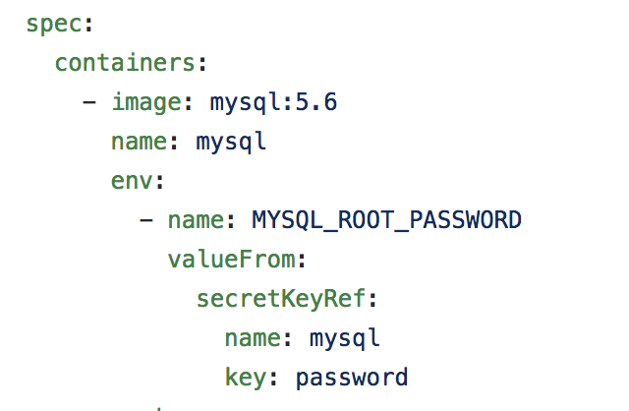
Using Secrets
$ kubectl create secret generic mysql --from-literal=password=12345
Agile Brains Consulting
58
©Agile Brains Consulting Inc. All rights reserved. Not to be reproduced without prior written consent.

Slide 59
ConfigMap
Agile Brains Consulting
59
©Agile Brains Consulting Inc. All rights reserved. Not to be reproduced without prior written consent.

Slide 60
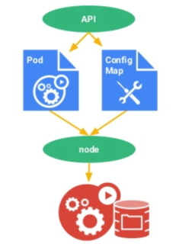
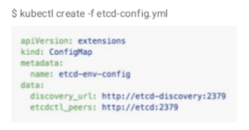
Kubernetes: Configmap
A set of key-value pairs that serve as configuration data for pods. They solve the problem of how to pass config data such as environment variables to pods.
Config maps are commonly composed of:
Command line arguments
Environment variables
Files in a volume
Config maps function similar to secrets, but values are stored as strings and are more readily readable.
Agile Brains Consulting
60
©Agile Brains Consulting Inc. All rights reserved. Not to be reproduced without prior written consent.
Notes:
http://pwittrock.github.io/docs/user-guide/configmap/
Extra resources:
https://docs.openshift.org/latest/dev_guide/configmaps.html

Slide 61
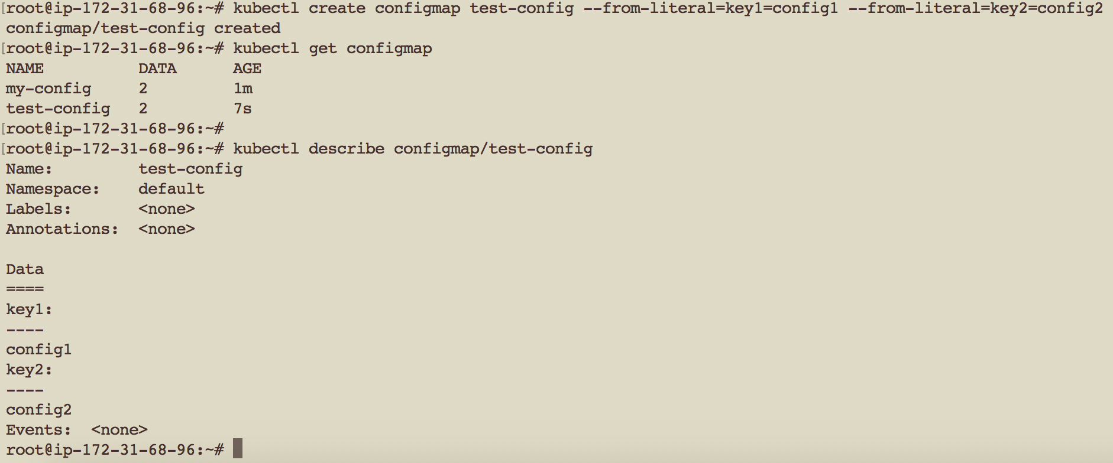
Kubernetes: Config Map
Agile Brains Consulting
61
©Agile Brains Consulting Inc. All rights reserved. Not to be reproduced without prior written consent.
Notes:
http://pwittrock.github.io/docs/user-guide/configmap/
Extra resources:
https://docs.openshift.org/latest/dev_guide/configmaps.html

Slide 62
Kubernetes: Config Map
apiVersion: v1
kind: Pod
metadata:
name: pod-with-cm
spec:
containers:
- name: test-container
image: k8s.gcr.io/busybox
command: [ "/bin/sh", "-c", "env" ]
env:
- name: SPECIAL_LEVEL_KEY
valueFrom:
configMapKeyRef:
name: test-cm
key: key1
restartPolicy: Never
apiVersion: v1
kind: ConfigMap
metadata:
name: test-cm
labels:
name: test-cm
data:
key1: value1
key2: value2
Agile Brains Consulting
62
©Agile Brains Consulting Inc. All rights reserved. Not to be reproduced without prior written consent.
Notes:
http://pwittrock.github.io/docs/user-guide/configmap/
Extra resources:
https://docs.openshift.org/latest/dev_guide/configmaps.html

Slide 63
Lab (Config Maps)
Create a deployment which uses hard coded value for log-level
Create a Config Map
Use the Config map inside a deployment
cd to ex14
https://github.com/shekhar2010us/kubernetes_teach_git/blob/master/ex14/configmap.md
Agile Brains Consulting
63
©Agile Brains Consulting Inc. All rights reserved. Not to be reproduced without prior written consent.
Notes:
https://github.com/gravitational/workshop/blob/master/k8s101.md
Git clone https://github.com/gravitational/workshop.git
Sections:
Deployments and Replicasets
Services
Back to Deployments
Configuration management basics

Slide 64
Daemonset
Agile Brains Consulting
64
©Agile Brains Consulting Inc. All rights reserved. Not to be reproduced without prior written consent.

Slide 65
Kubernetes: DaemonSet
A DaemonSet ensures that all (or some) Nodes run a copy of a Pod. As nodes are added to the cluster, Pods are added to them. As nodes are removed from the cluster, those Pods are garbage collected. Deleting a DaemonSet will clean up the Pods it created.
- Usually used for pods meant for Monitoring or collecting logs
Agile Brains Consulting
65
©Agile Brains Consulting Inc. All rights reserved. Not to be reproduced without prior written consent.

Slide 66
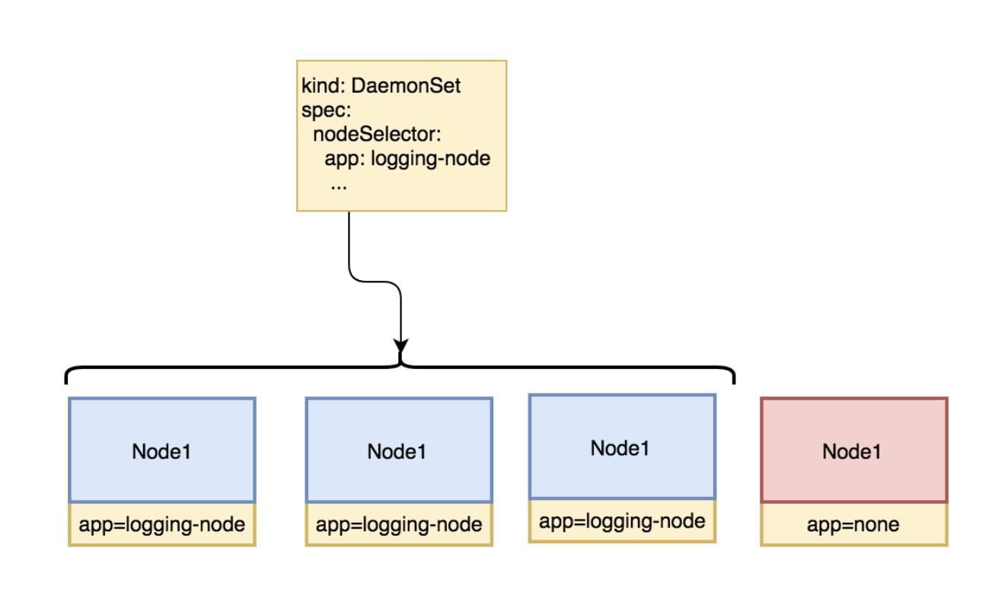
Kubernetes: DaemonSet
Agile Brains Consulting
66
©Agile Brains Consulting Inc. All rights reserved. Not to be reproduced without prior written consent.

Slide 67
DaemonSet example
apiVersion: extensions/v1beta1
kind: DaemonSet
metadata:
name: logging
spec:
template:
metadata:
labels:
app: logging-app
spec:
nodeSelector:
app: logging-node
containers:
- name: webserver
image: nginx
ports:
- containerPort: 80
Looks like pod
How to assign labels to nodes?
If node exists
kubectl label nodes <node-name> <label-key>=<label-value>
While provisioning
--node-labels <label-key>=<label-value>
Agile Brains Consulting
67
©Agile Brains Consulting Inc. All rights reserved. Not to be reproduced without prior written consent.

Slide 68
Jobs
Agile Brains Consulting
68
©Agile Brains Consulting Inc. All rights reserved. Not to be reproduced without prior written consent.

Slide 69
Kubernetes: Jobs and Cron Jobs
Jobs - Creates one or more pods and ensures that a specified number of them successfully terminate. As pods successfully complete, the job tracks the successful completions. When a specified number of successful completions is reached, the job itself is complete. Deleting a Job will cleanup the pods it created, and is run one-time
Cron Job - A Cron Job creates Jobs on a time-based schedule. One Cron Job object is like one line of a crontab (cron table) file. It runs a job periodically on a given schedule
Agile Brains Consulting
69
©Agile Brains Consulting Inc. All rights reserved. Not to be reproduced without prior written consent.
Notes:
https://kubernetes.io/docs/concepts/workloads/controllers/statefulset/

Slide 70
Lab (Jobs and Cron Jobs)
Create Job and check the logs
Create a Cron Job,
Edit the Cron Job
cd to ex9
https://github.com/shekhar2010us/kubernetes_teach_git/blob/master/ex9/cronjob.md
Agile Brains Consulting
70
©Agile Brains Consulting Inc. All rights reserved. Not to be reproduced without prior written consent.
Notes:
https://github.com/gravitational/workshop/blob/master/k8s101.md
Git clone https://github.com/gravitational/workshop.git
Sections:
Deployments and Replicasets
Services
Back to Deployments
Configuration management basics

Slide 71
How to assign pods to nodes
Agile Brains Consulting
71
©Agile Brains Consulting Inc. All rights reserved. Not to be reproduced without prior written consent.

Slide 72
Kubernetes: Assigning Pods to Nodes
You can constrain a pod to only be able to run on particular nodes or to prefer to run on particular nodes. There are several ways to do this, and the recommended approaches all use label selectors to make the selection.
nodeSelector is the simplest recommended form of node selection constraint.
nodeSelector is a field of PodSpec. It specifies a map of key-value pairs. For the pod to be eligible to run on a node, the node must have each of the indicated key-value pairs as labels (it can have additional labels as well). The most common usage is one key-value pair.
Agile Brains Consulting
72
©Agile Brains Consulting Inc. All rights reserved. Not to be reproduced without prior written consent.

Slide 73
Kubernetes: nodeSelector Example
Step1: Label the nodes
kubectl label nodes <node-name> <label-key>=<label-value>
Eg:- kubectl label nodes kubernetes-foo-node-1.c.a-test.internal disktype=ssd
Step2: Assign the Pod creation on node with label ‘disktype’ and value ‘ssd’
kubectl create -f pod-nginx.yaml
apiVersion: v1
kind: Pod
metadata:
name: nginx
labels:
env: test
spec:
containers:
- name: nginx
image: nginx
imagePullPolicy: IfNotPresent
nodeSelector:
disktype: ssd
spec:
affinity:
nodeAffinity:
nodeSelectorTerms:
- matchExpressions:
- key: kubernetes.io/e2e-az-name
operator: In
values:
- e2e-az1
- e2e-az2
Agile Brains Consulting
73
©Agile Brains Consulting Inc. All rights reserved. Not to be reproduced without prior written consent.

Slide 74
Pod Priority and pre-emption
Agile Brains Consulting
74
©Agile Brains Consulting Inc. All rights reserved. Not to be reproduced without prior written consent.

Slide 75
Kubernetes: Pod Priority
Pods can have priority. Priority indicates the importance of a Pod relative to other Pods. If a Pod cannot be scheduled, the scheduler tries to pre-empt (evict) lower priority Pods to make scheduling of the pending Pod possible.
Agile Brains Consulting
75
©Agile Brains Consulting Inc. All rights reserved. Not to be reproduced without prior written consent.
Notes:
-- can have any priority between 1 to 1 billion - 10^9, because 1 billion 1 is assigned to kube-system resources

Slide 76
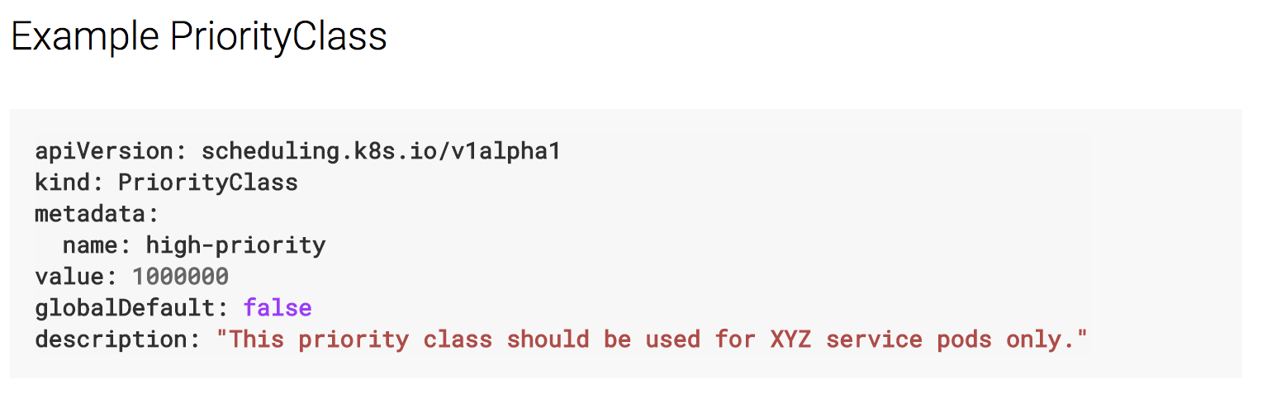
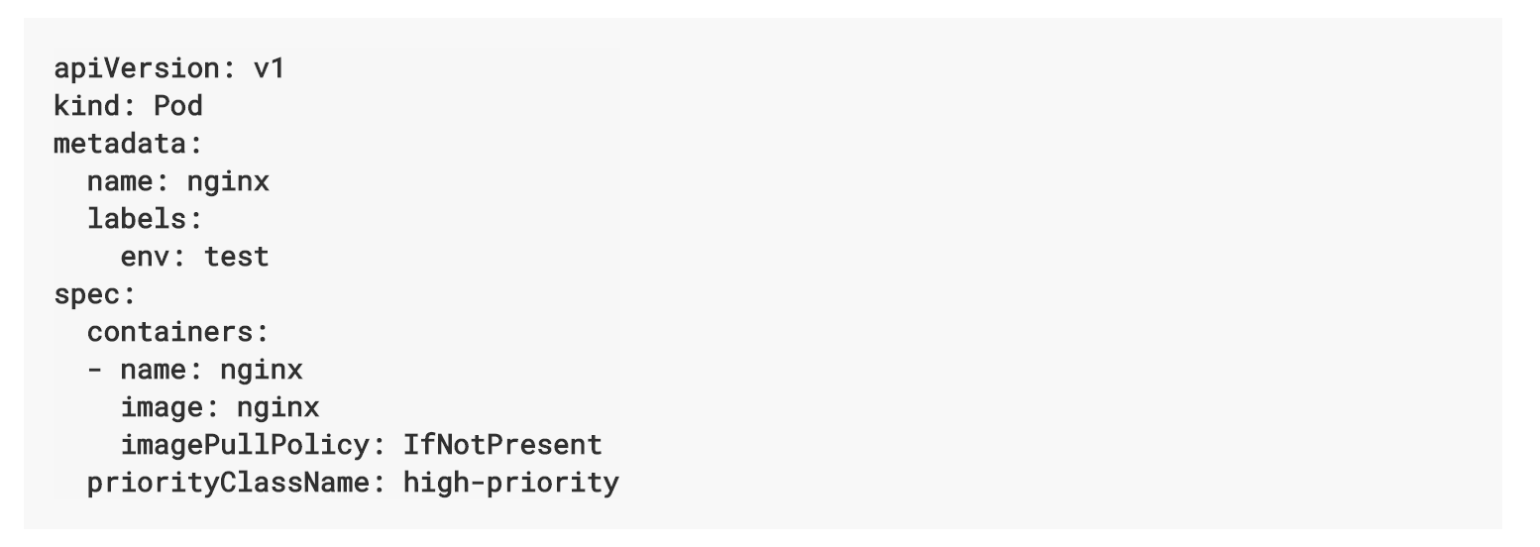
Kubernetes: Pod Priority
Set the priority for pod scheduling but cannot ask never to kill a pod
Agile Brains Consulting
76
©Agile Brains Consulting Inc. All rights reserved. Not to be reproduced without prior written consent.
Notes:
-- can have any priority between 1 to 1 billion - 10^9, because 1 billion 1 is assigned to kube-system resources

Slide 77
Pod Pre-emption
When Pods are created, they go to a queue and wait to be scheduled. The scheduler picks a Pod from the queue and tries to schedule it on a Node. If no Node is found that satisfies all the specified requirements of the Pod, pre-emption logic is triggered for the pending Pod.
Agile Brains Consulting
77
©Agile Brains Consulting Inc. All rights reserved. Not to be reproduced without prior written consent.
Notes:
-- can have any priority between 1 to 1 billion - 10^9, because 1 billion 1 is assigned to kube-system resources

Slide 78
Node Taints
Agile Brains Consulting
78
©Agile Brains Consulting Inc. All rights reserved. Not to be reproduced without prior written consent.

Slide 79
Kubernetes: Node taints
Node Taints is a property of pods that repel them to a set of nodes
Taints ensure that pods are not scheduled onto inappropriate nodes. One or more taints are applied to a node; this marks that the node should not accept any pods that do not tolerate the taints.
Agile Brains Consulting
79
©Agile Brains Consulting Inc. All rights reserved. Not to be reproduced without prior written consent.
Notes:
-- can have any priority between 1 to 1 billion - 10^9, because 1 billion 1 is assigned to kube-system resources

Slide 80
Adding and removing a taint to node
Tainting a node named ‘node1’
kubectl taint nodes node1 key=value:NoSchedule
Taint effect NoSchedule means no Pod will be able to schedule onto node1 until it has matching toleration (key=value)
Removing taint of the node ‘node1’
kubectl taint nodes node1 key=value:NoSchedule-
Agile Brains Consulting
80
©Agile Brains Consulting Inc. All rights reserved. Not to be reproduced without prior written consent.
Notes:
-- can have any priority between 1 to 1 billion - 10^9, because 1 billion 1 is assigned to kube-system resources

Slide 81
Kubernetes: Node role
A node role is just a label with the format:
node-role.kubernetes.io/<role>
It can be added using kubectl label command
Adding a role to node
kubectl label test.node.test.com node-role.kubernetes.io/worker
Removing a role from node
kubectl label test.node.test.com node-role.kubernetes.io/worker-
Recall how to add a label:
kubectl label nodes <node-name> <label-key>=<label-value>
Agile Brains Consulting
81
©Agile Brains Consulting Inc. All rights reserved. Not to be reproduced without prior written consent.
Notes:
-- can have any priority between 1 to 1 billion - 10^9, because 1 billion 1 is assigned to kube-system resources

Slide 82
Resource quotas
Agile Brains Consulting
82
©Agile Brains Consulting Inc. All rights reserved. Not to be reproduced without prior written consent.

Slide 83
Kubernetes: Resource Quotas
When several users or teams share a cluster with a fixed number of nodes, there is a concern that one team could use more than its fair share of resources.
Resource quotas are a tool for administrators to address this concern.
It is defined by “ResourceQuota” object. It provides constraints that limit aggregate resource consumption per namespace.
Agile Brains Consulting
83
©Agile Brains Consulting Inc. All rights reserved. Not to be reproduced without prior written consent.
Notes:
-- can have any priority between 1 to 1 billion - 10^9, because 1 billion 1 is assigned to kube-system resources

Slide 84
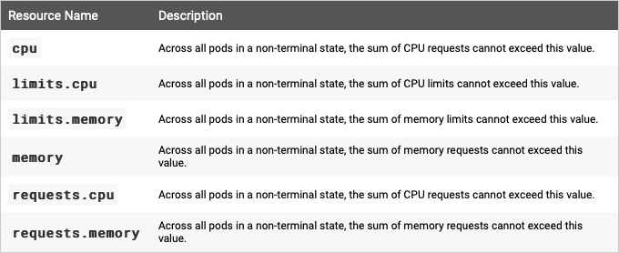
Kubernetes: Compute Resource Quotas
Agile Brains Consulting
84
©Agile Brains Consulting Inc. All rights reserved. Not to be reproduced without prior written consent.
Notes:
-- can have any priority between 1 to 1 billion - 10^9, because 1 billion 1 is assigned to kube-system resources

Slide 85
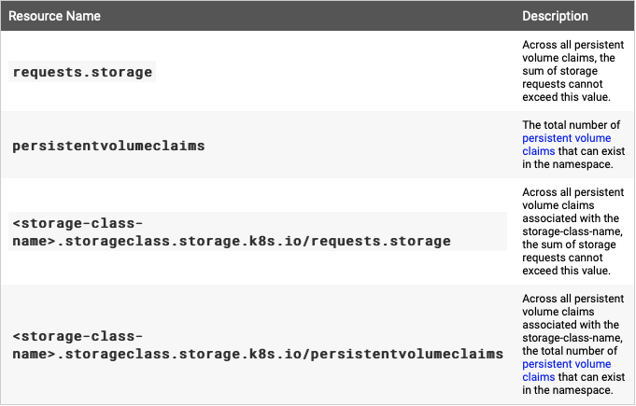
Kubernetes: Storage Resource Quotas
Agile Brains Consulting
85
©Agile Brains Consulting Inc. All rights reserved. Not to be reproduced without prior written consent.
Notes:
-- can have any priority between 1 to 1 billion - 10^9, because 1 billion 1 is assigned to kube-system resources

Slide 86
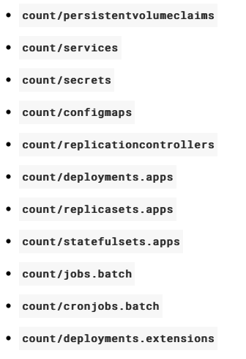
Kubernetes: Object Count Quotas
Agile Brains Consulting
86
©Agile Brains Consulting Inc. All rights reserved. Not to be reproduced without prior written consent.
Notes:
-- can have any priority between 1 to 1 billion - 10^9, because 1 billion 1 is assigned to kube-system resources

Slide 87
Kubernetes: Resource Quotas Example
cpu_memory_quota.yml
compute_quota.yml
apiVersion: v1
kind: ResourceQuota
metadata:
name: pods-medium
spec:
hard:
cpu: "10"
memory: 20Gi
pods: "10"
scopeSelector:
matchExpressions:
- operator : In
scopeName: PriorityClass
values: ["medium"]
apiVersion: v1
kind: ResourceQuota
metadata:
name: compute-resources
spec:
hard:
pods: "4"
requests.cpu: "1"
requests.memory: 1Gi
limits.cpu: "2"
limits.memory: 2Gi
Agile Brains Consulting
87
©Agile Brains Consulting Inc. All rights reserved. Not to be reproduced without prior written consent.
Notes:
-- can have any priority between 1 to 1 billion - 10^9, because 1 billion 1 is assigned to kube-system resources

Slide 88
Kubernetes: Limit Resource by Pods
apiVersion: v1
kind: Pod
spec:
containers:
- name: db
…
resources:
requests:
memory: "64Mi"
cpu: "250m"
limits:
memory: "128Mi"
cpu: "500m"
- name: wp
…
resources:
requests:
memory: "64Mi"
cpu: "250m"
limits:
memory: "128Mi"
cpu: "500m"
pod.yml
Agile Brains Consulting
88
©Agile Brains Consulting Inc. All rights reserved. Not to be reproduced without prior written consent.
Notes:
-- can have any priority between 1 to 1 billion - 10^9, because 1 billion 1 is assigned to kube-system resources

Slide 89
Kubernetes Authentication and Access Control

Slide 90
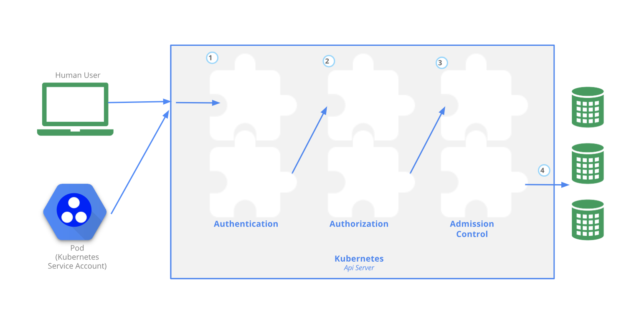
Control Access to APIs
Human users and K8s service accounts can be authorized for API access.
When a request reaches the API, it goes through 3 stages.
Authentication
Authorization
Admission Control
Agile Brains Consulting
90
©Agile Brains Consulting Inc. All rights reserved. Not to be reproduced without prior written consent.

Slide 91
Step 1: Authentication
HTTP request is passed to the authenticator to authenticate the user.
Type of authenticator (set by cluster admin):
client certificate ($USER/.kube/config contains root certificate for api-server certificate)
password
plain token
bootstrap token
* If the admin sets multiple, this step checks all and grants access even if one is passed.
Status:
pass: the user is authenticated as "username", and this "username" is available to subsequent steps.
fail: 401 code
Agile Brains Consulting
91
©Agile Brains Consulting Inc. All rights reserved. Not to be reproduced without prior written consent.

Slide 92
Step 2: Authorization
After successful authentication, the HTTP request is authorized for existing "policies"
HTTP request contains {"username", "requested action", "objects getting affected"}
Type of authorizers (set by cluster admin):
RBAC – Role based access control
ABAC – Attribute based access control
RBAC and ABAC allows the cluster-admin to dynamically configure policies through the Kubernetes API to grant restricted access.
* If the admin sets multiple, this step checks all and grants access even if one is passed.
Agile Brains Consulting
92
©Agile Brains Consulting Inc. All rights reserved. Not to be reproduced without prior written consent.

Slide 93
RBAC (Role based Access Control)
Role – are additive rules with set of permissions. (no "deny" rules)
API group: rbac.authorization.k8s.io
Enable api-server with: --authorization-mode=RBAC
Type of Roles:
Role – within a namespace
ClusterRole – within the cluster
Agile Brains Consulting
93
©Agile Brains Consulting Inc. All rights reserved. Not to be reproduced without prior written consent.

Slide 94
Role
# role for accessing pods in default namespace
kind: Role apiVersion: rbac.authorization.k8s.io/v1 metadata: namespace: default name: pod-reader rules: - apiGroups: [""] # "" is core API group resources: ["pods"] verbs: ["get", "watch", "list"]
# role using resourceNames
rules: - apiGroups: [""] resources: ["configmaps"]
resourceNames: ["my-configmap"] verbs: ["update", "get"]
Check all endpoints
$ kubectl proxy &
$ curl localhost:8001
# The above role won't be able to access pod logs # {pod = namespaced resource}, {logs = is not}
rules: - apiGroups: [""] resources: ["pods", "pods/log"] verbs: ["get", "list"]
# role for a non-resource endpoint
rules: - nonResourceURLs: ["/healthz", "/healthz/*"] verbs: ["get", "post"]
Agile Brains Consulting
94
©Agile Brains Consulting Inc. All rights reserved. Not to be reproduced without prior written consent.

Slide 95
RoleBinding
RoleBinding – refer subjects (users, groups, or service accounts) to a role
# A role binding allows "Mary" to read
# pods in the "default" namespace kind: RoleBinding apiVersion: rbac.authorization.k8s.io/v1 metadata: name: read-pods namespace: default subjects: - kind: User name: Mary # case sensitive apiGroup: rbac.authorization.k8s.io roleRef: kind: Role name: pod-reader apiGroup: rbac.authorization.k8s.io
# binding for a group subjects: - kind: Group name: "frontend-admins"
# default service account in the kube-system namespace subjects: - kind: ServiceAccount name: default namespace: kube-system
# binding for all service accounts in the "qa" namespace subjects: - kind: Group name: system:serviceaccounts:qa
Agile Brains Consulting
95
©Agile Brains Consulting Inc. All rights reserved. Not to be reproduced without prior written consent.

Slide 96
Question – why need namespace for a RoleBinding when it is already scoped and defined in a Role?
Answer – A RoleBinding may also refer a ClusterRole to grant the permissions to namespaced resources defined in the ClusterRole within the RoleBinding’s namespace.
E.g. for a ClusterRole that reads secrets in all namespace, if you define a RoleBinding (with namespace=n1) referring to the ClusterRole, the user will read secrets in the namespace=n1 only not in all namespace (which was the scope of ClusterRole)
Agile Brains Consulting
96
©Agile Brains Consulting Inc. All rights reserved. Not to be reproduced without prior written consent.

Slide 97
ClusterRole
ClusterRole = Roles defined for the entire cluster
ClusterRole = Role + cluster resources (like nodes) + non-resource (like /healtz) + not limited to one namespace
# ClusterRole to read secrets across all namespace
kind: ClusterRole apiVersion: rbac.authorization.k8s.io/v1 metadata: # no "namespace”, ClusterRoles are not namespaced name: secret-reader rules: - apiGroups: [""] resources: ["secrets"] verbs: ["get", "watch", "list"]
Agile Brains Consulting
97
©Agile Brains Consulting Inc. All rights reserved. Not to be reproduced without prior written consent.

Slide 98
ClusterRole Binding
ClusterRoleBinding – refer subjects (users, groups, or service accounts) to a ClusterRole
# This cluster role binding allows anyone in the "manager" group to read secrets in any namespace. kind: ClusterRoleBinding apiVersion: rbac.authorization.k8s.io/v1 metadata: name: read-secrets-global subjects: - kind: Group name: manager # Name is case sensitive apiGroup: rbac.authorization.k8s.io roleRef: kind: ClusterRole name: secret-reader apiGroup: rbac.authorization.k8s.io
Agile Brains Consulting
98
©Agile Brains Consulting Inc. All rights reserved. Not to be reproduced without prior written consent.

Slide 99
ABAC (Attribute based Access Control)
Defines an access control paradigm whereby access rights are granted to users through the
use of policies which combine attributes together
API group: abac.authorization.k8s.io
Enable api-server with: --authorization-mode=ABAC
Provide api-server with access file: --authorization-policy-file=SOME_FILENAME
Each line in the policy file is the policy JSON object
Agile Brains Consulting
99
©Agile Brains Consulting Inc. All rights reserved. Not to be reproduced without prior written consent.

Slide 100
ABAC Policies
# John has read-only access to pods in 'developer' namespace
{ "apiVersion": "abac.authorization.kubernetes.io/v1beta1", "kind": "Policy", "spec": { "user": "john200", "namespace": "developer", "resource": "pods", "readonly": true } }
ServiceAccount: is identified by "system:serviceaccount:<namespace>:<serviceaccountname>"
# default service account (in the kube-system namespace) full privilege to the API
{ "apiVersion": "abac.authorization.kubernetes.io/v1beta1", "kind": "Policy", "spec": { "user": "system:serviceaccount:kube-system:default", "namespace": "*", "resource": "*", "apiGroup": "*" } }
Agile Brains Consulting
100
©Agile Brains Consulting Inc. All rights reserved. Not to be reproduced without prior written consent.

Slide 101
Step 3: Admission Control
Checks if the user requesting for a write operation has the necessary permission to bring the change in the K8s resource. Thus, happens prior to persistence of the object.
Enable: kube-apiserver --enable-admission-plugins=NamespaceLifecycle,LimitRanger
Plugins enabled by default: NamespaceLifecycle, ServiceAccount, PersistentVolumeClaimResize, DefaultStorageClass, ResourceQuota, Priority
* Many advanced features in Kubernetes require an admission controller to be enabled in order to properly support the feature.
Agile Brains Consulting
101
©Agile Brains Consulting Inc. All rights reserved. Not to be reproduced without prior written consent.

Slide 102
Service Accounts
-- Provides an identity for processes that runs in a Pod
Human users are authenticated by the api-server as a particular User account.
Processes in containers inside pods are authenticated by the api-server as a particular Service account.
When a pod is created;
spec.serviceAccountName mentions the ServiceAccount, "default" is auto assigned.
The API permissions of the service account is defined in the authorization policy (RBAC or ABAC) as discussed earlier.
Agile Brains Consulting
102
©Agile Brains Consulting Inc. All rights reserved. Not to be reproduced without prior written consent.

Slide 103
Service Accounts – Tokens
# create a service account named acc1 apiVersion: v1 kind: ServiceAccount metadata: name: acc1
auto-create token
secrets: - name: acc1-token-bvbk5
# manually created token and use for a service account
apiVersion: v1 kind: Secret metadata: name: acc1-secret annotations: kubernetes.io/service-account.name: acc1 type: kubernetes.io/service-account-token
# create a pod using acc1 service account apiVersion: v1 kind: Pod metadata: name: my-pod spec: serviceAccountName: acc1
Agile Brains Consulting
103
©Agile Brains Consulting Inc. All rights reserved. Not to be reproduced without prior written consent.

Slide 104
Service Accounts – ImagePullSecret
Case: Provide specific access to serviceaccounts (in turn pods) to pull images from multiple docker registries
Create a ImagePullSecret
$ kubectl create secret docker-registry myregistrykey --docker-server=DOCKER_REGISTRY_SERVER --docker-username=DOCKER_USER --docker-password=DOCKER_PASSWORD --docker-email=DOCKER_EMAIL
Change the service account to use the above ImagePullSecret
$ kubectl patch serviceaccount default -p '{"imagePullSecrets": [{"name": "myregistrykey"}]}’
* Now the pod using the serviceaccount “default” will use the secret to pull images from the specific docker registry
Agile Brains Consulting
104
©Agile Brains Consulting Inc. All rights reserved. Not to be reproduced without prior written consent.

Slide 105
Service Accounts – Pod creation
Case: What happens with ServiceAccount when a Pod is created
If the pod does not have a ServiceAccount set, it sets the ServiceAccount to default.
It ensures that the ServiceAccount referenced by the pod exists, and otherwise rejects it.
If the pod does not contain any ImagePullSecrets, then ImagePullSecrets of the ServiceAccount are added to the pod.
It adds a volume to the pod which contains a token for API access.
It adds a volumeSource to each container of the pod mounted at /var/run/secrets/kubernetes.io/serviceaccount
We have seen this in one of the exercises where two containers in the same pod trying to share volumes – was authenticated by serviceaccount secret that was auto-created
Agile Brains Consulting
105
©Agile Brains Consulting Inc. All rights reserved. Not to be reproduced without prior written consent.

